Slide 1
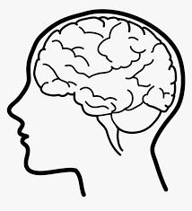
Primitive Brain
Project Proposal

Slide 2
Outline
Objective
Problem Statement
Model 1
Model 2
Model 3
Model 4

Slide 3
The aim of this project is to use different models trained for different tasks to work together like multitasking ability of the brain to give correct output for a given task

Slide 4
Problem statement
In this problem we are trying to mimic the brain's ability to perform multitasking.
Here we are using multiple models trained on different tasks to work together to give output for a given task.

Slide 5

Model 1
01
1
Pokemon Classifier

Slide 6
Dataset
The dataset contains 151 folders, one for each gen 1 pokemon and each folder contains 60 image for every pokemon.
In all there are over 10,000+ images
https://www.kaggle.com/datasets/thedagger/pokemon-generation-one

Slide 7
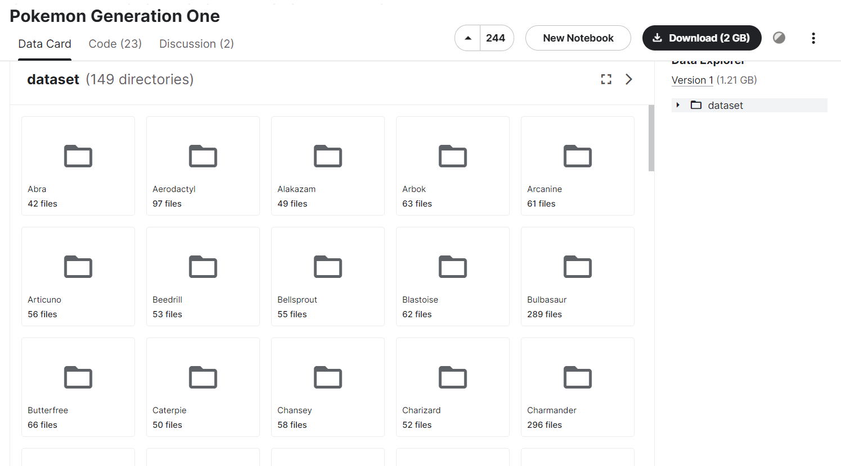

Slide 8
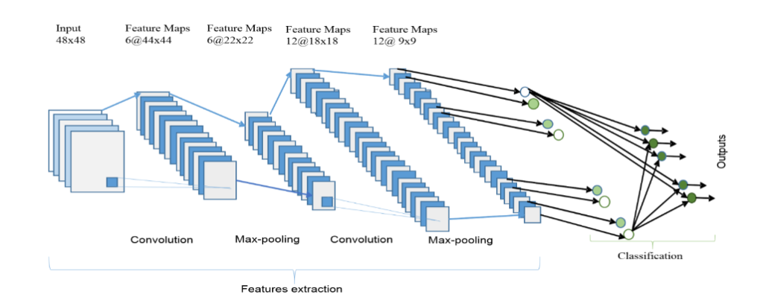
Model Architecture

Slide 9
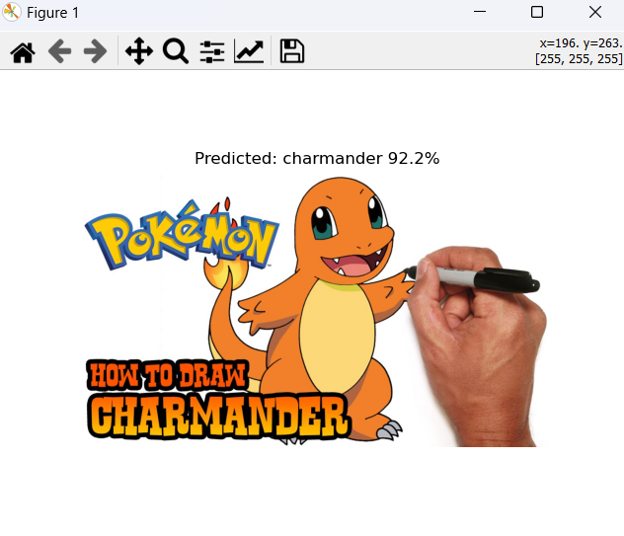
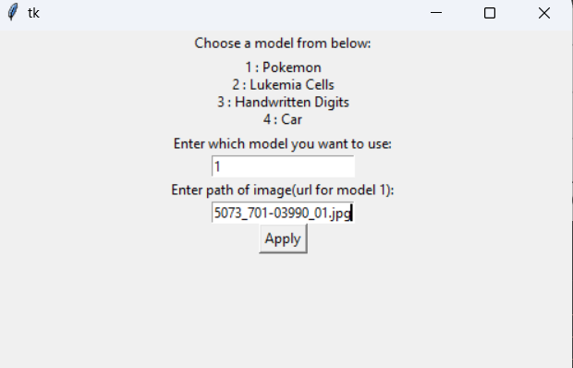
Output

Slide 10
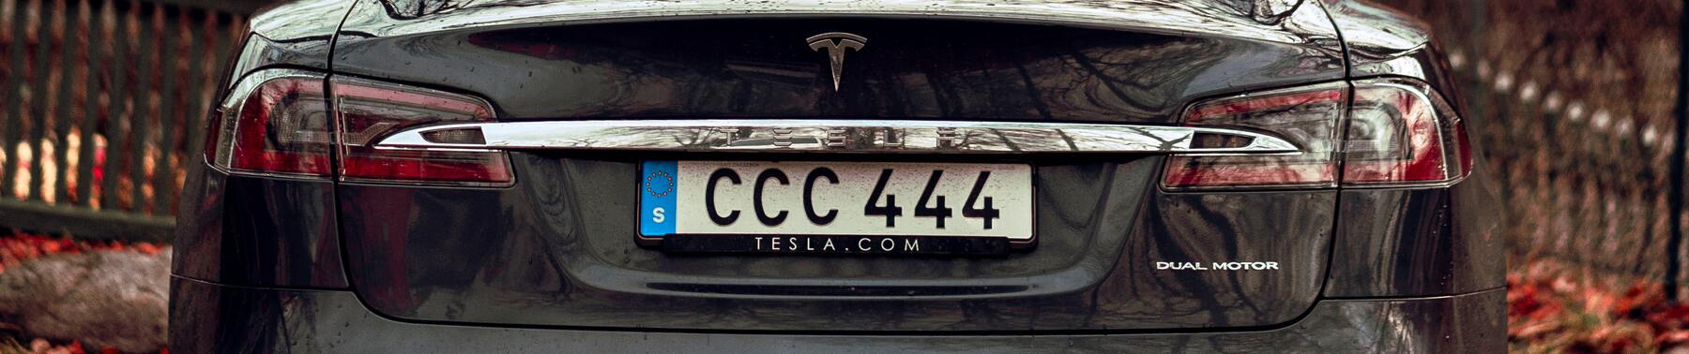
Model 2
02
Car License Plate Detection and Reader

Slide 11
Dataset
This dataset contains 433 images with bounding box annotations of the car license plates within the image.
Annotations are provided in the PASCAL VOC format.
https://www.kaggle.com/datasets/andrewmvd/car-plate-detection?select=images

Slide 12
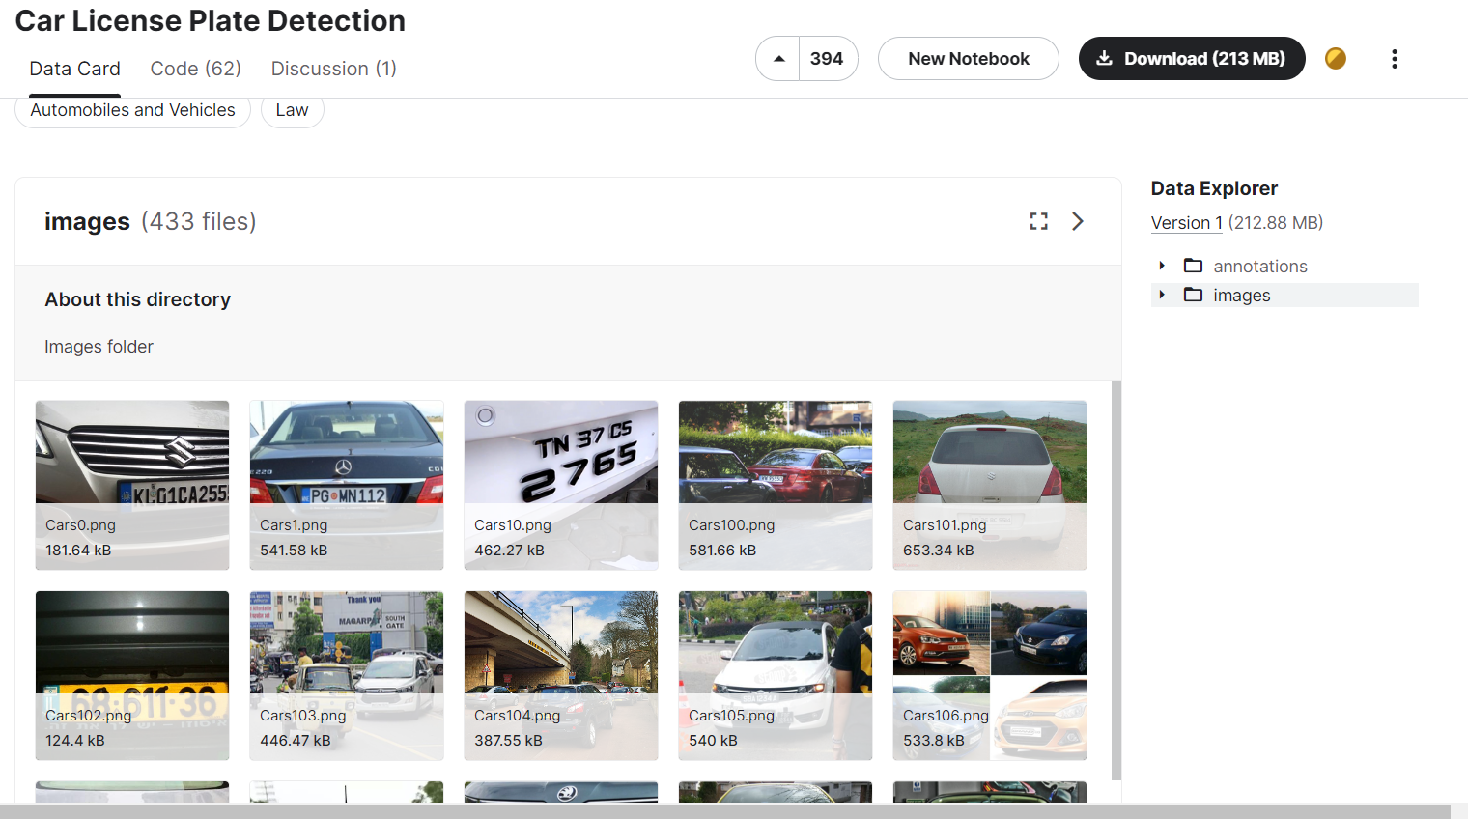

Slide 13
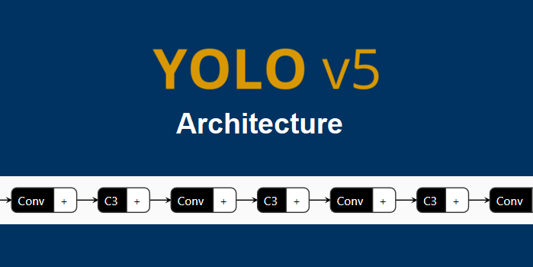
Model Architecture

Slide 14
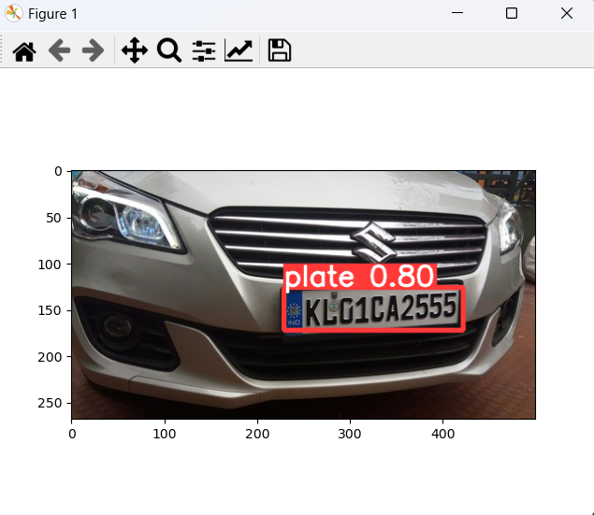
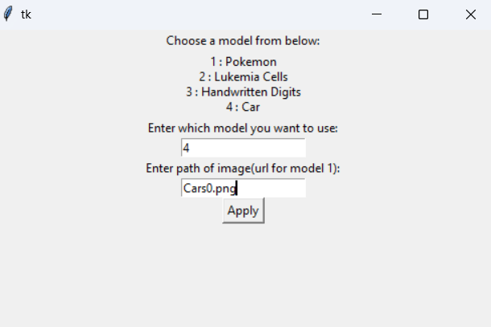
Output

Slide 15
Model 3
03
Blood Cells Cancer Detection

Slide 16
The images of this dataset were prepared in the bone marrow laboratory of Taleqani Hospital (Tehran, Iran).
This dataset consisted of 3242 PBS images from 89 patients suspected of ALL, whose blood samples were prepared and stained by skilled laboratory staff. This dataset is divided into two classes
benign
malignant

Slide 17
Dataset
The former comprises hematogenous, and the latter is the ALL group with three subtypes of malignant lymphoblasts:
Early Pre-B
Pre-B
Pro-B ALL.
All the images were taken by using a Zeiss camera in a microscope with a 100x magnification and saved as JPG files.
https://www.kaggle.com/datasets/mohammadamireshraghi/blood-cell-cancer-all-4class

Slide 18
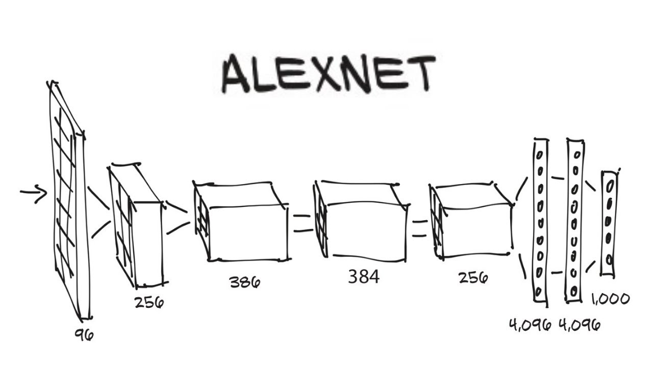
Model Architecture

Slide 19
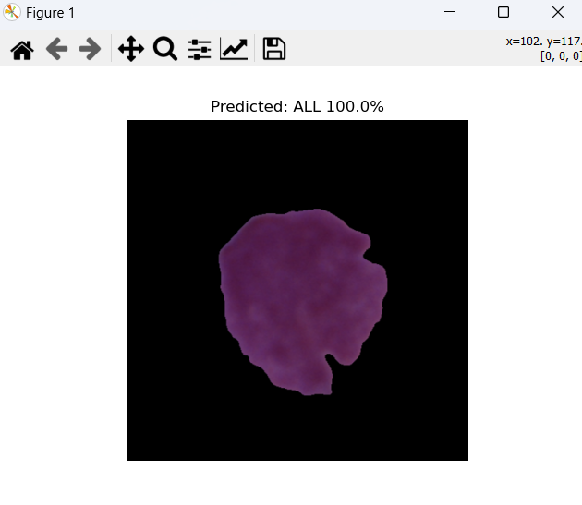
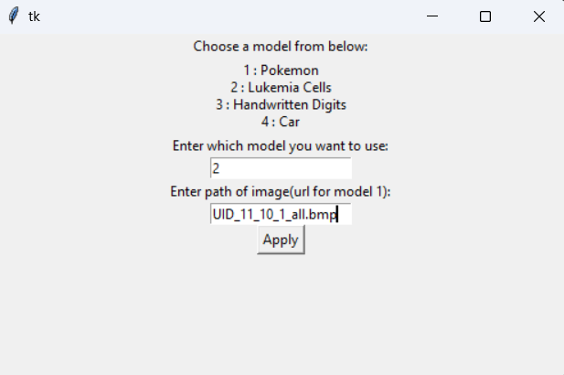
Output

Slide 20
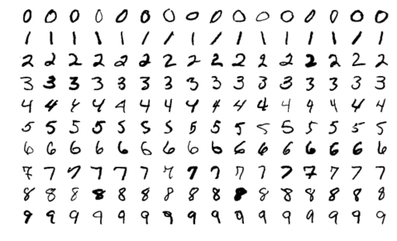
Model 4
04
Handwritten Digit Recognition for kids

Slide 21
Dataset
The MNIST database (Modified National Institute of Standards and Technology database) is a large database of handwritten digits that is commonly used for training various image processing systems.
The black and white images from NIST were normalized to fit into a 28x28 pixel bounding box and anti-aliased, which introduced grayscale levels.
The MNIST database contains 60,000 training images and 10,000 testing images. Half of the training set and half of the test set were taken from NIST's training dataset, while the other half of the training set and the other half of the test set were taken from NIST's testing dataset.

Slide 22

Model Architecture

Slide 23

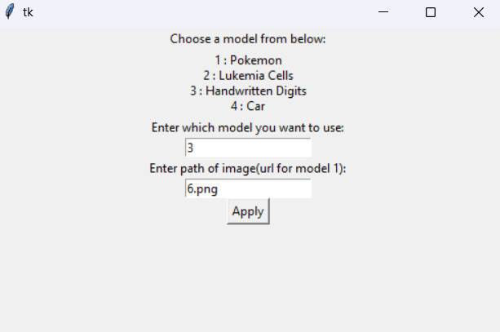
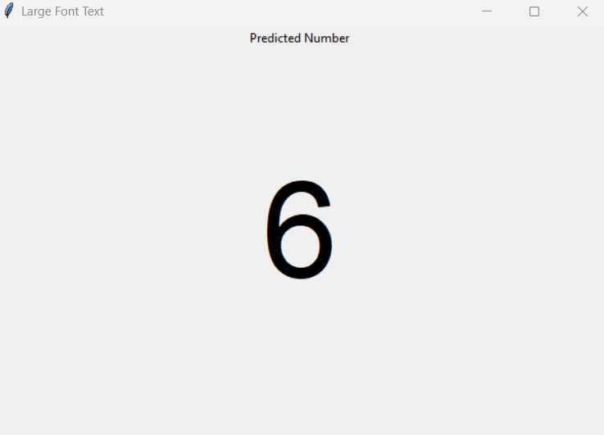
Output
Input

Slide 24
Team Members
Name | Register Number
Arnab Banarjee | RA2011047010002
Abhinn Daga | RA2011047010007
Roshan Upadhyay | RA2011047010015
Glenn Paul Aby | RA2011047010017
Yash Singh | RA2011047010019

Slide 25


THANK YOU!

